Slide 1

Optimization of Classifiers for Person Detection
By :
Shiva Kumar Biru (1436929)
Guided By:
Prof. Dr. Andreas Pech .
Module: Individual Project

Slide 2

Table of Contents
Methodology
Red Pitaya
Ultrasonic sensor
Classifiers
GUI-panel
Introduction
Implementation
Set up & Data Collection
Data processing
Classifiers setup
GUI-panel
Conclusion
Results

Slide 3

Introduction
Today's technology makes it relatively simple to find an efficient solution for a person's detection and recognition in an office environment.
Our study focuses on the critical task of accurately detecting individuals within office environments.
We aim to assess the performance and reliability of a sensor system designed for this purpose, particularly in identifying individuals in the office environment with different classifiers.
We aim to optimize the classifier for better person detection.

Slide 4

Methodology

Slide 5
Red Pitaya
Red Pitaya serves as a powerful and flexible embedded system platform that can be used for a variety of measurement, control, and signal processing applications.
we utilized the Ultrasonic Sensor SRF02
It transfers data wirelessly to the connected laptop for additional processing
It operates in the frequency range of 50MHz

Slide 6
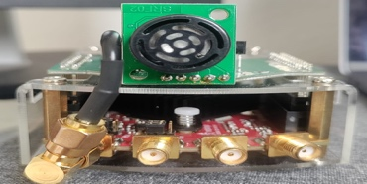
Ultrasonic Sensor
The SRF02 Ultrasonic Sensor is a compact single transducer ultrasonic rangefinder integrated into a small PCB.
Its minimum range surpasses that of other dual transducer rangers.
It functions with a 5V grounded power supply.
The sensor operates under the GNU/Linux operating system.

Slide 7
Classifiers
Classifers
Random forest classfier
SVM
Logistic regression
XG Boost
Gradient Boosting classifier

Slide 8
Panel -GUI
The "panel" library is a Python package that provides a high-level interface for creating interactive web-based dashboards and applications. It is designed to work seamlessly with other popular data science and visualization libraries in Python, such as Pandas, Matplotlib, and Bokeh.
Panel allows you to build custom interactive web interfaces for your data analysis, visualization. It provides a set of flexible and powerful components for creating interactive plots, tables, sliders, buttons, and other widgets, which can be organized and arranged in a layout that suits your needs.
With Panel, you can create interactive dashboards and applications directly from your Python code.

Slide 9


Slide 10
Sensor setup
Red pitaya sensor
2 meters

Slide 11
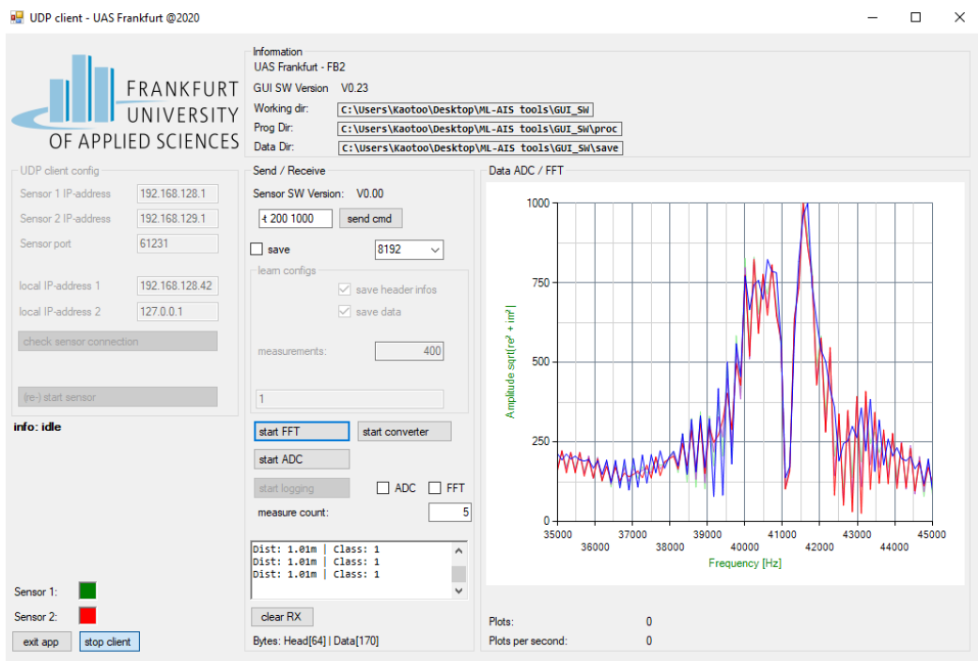
Measurement Software:
The data gathered from the Red Pitaya measurement board is processed utilizing measurement software created at Frankfurt University of Applied Sciences
The software has been set up to analyze either the analog data or raw data from the ultrasonic sensor.

Slide 12

Data Collection
Person Positions :
Seated normally in an upright position.
Seated sideways with body turned.
Leaning forward.
Leaning backward.
Entering the seat.
Exiting the seat.
Clothing Variations:
Each scenario tested with:
Long sleeves
Half sleeves
Unoccupied Seat Scenarios:
Seat Conditions Tested:
Completely empty.
Partially within sensor's range.
Seat set at a lower height.
Obstacle beside the seat or in place of it.
A laptop or book on the seat.
A bag on the seat.
Two empty seats within the sensor’s range.

Slide 13
Flow Chart
Start
.txt→.csv→Convert ADC to FFT data
Consider 30-50kHz
Save as .npy files
Evaluate model with test data
Train the Model
Predict values
Plot confusion matrix
stop

Slide 14

Data Preprocessing
The data is saved in the .txt format then converted to .csv
We consider the data of 30-50 kHz for the model training
Then, using the power of the Python modules Pandas and NumPy, a conversion procedure is used to turn the data into .npy files
After this conversion, the dataset is divided into two parts: 80% of the data is used for training the model, and the remaining 20% is kept for testing and prediction operations.

Slide 15
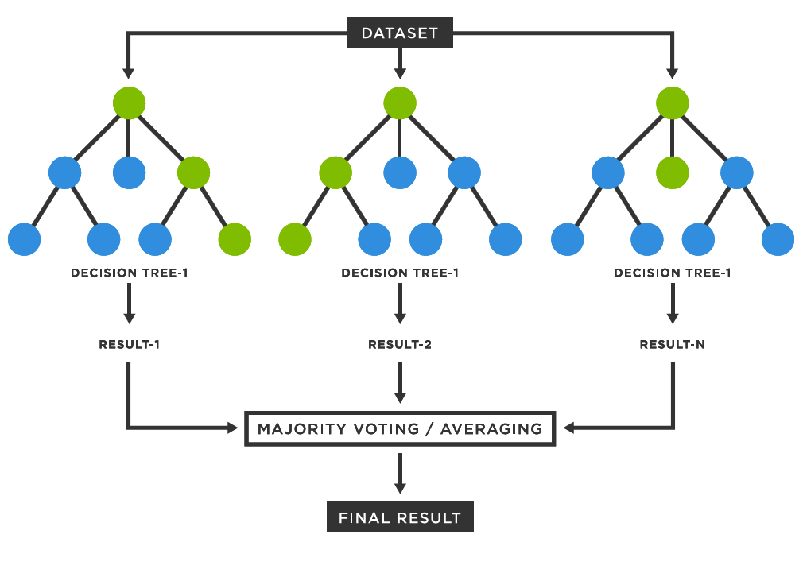
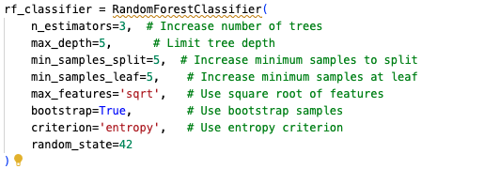
Random Forest Classifier
The data is loaded and split into training and testing data.
The model is defined with the below parameters.
The random_state=42 parameter ensures that the randomness in the algorithm's behavior is reproducible, as it sets the seed for the random number generator.
Once the Model is trained with our training data, we predict the labels for the Testing data and calculate the accuracy

Slide 16

SVM
The Python library 'sklearn.svm' is utilized to construct a model employing Support Vector Machines (SVM).
Data Processing:
Splitting: 80% training, 20% testing.
Imputation: Missing values replaced with the mean using SimpleImputer.
Model Pipeline:
Components:
SimpleImputer(strategy='mean')
SVC(C=60.0, kernel='rbf')
Training: Model trained on the training dataset.

Slide 17
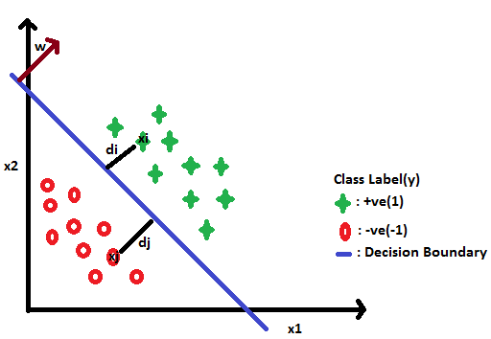
Logistic Regresssion
Logistic regression is a statistical method used for binary classification by modeling the probability of a certain class or event based on one or more predictor variables.
Model Configuration:
Algorithm: Logistic Regression
Solver: saga – optimized for large datasets and supports L2 regularization.
Regularization: C=0.001 – Strong regularization to prevent overfitting.
Multi-Class Handling: ovr (One-vs-Rest) – Suitable for binary and multiclass classification.
Penalty: l2 – Regularization technique that adds a penalty for large coefficients.
Iterations: max_iter=2 – Limited to 2 iterations, balancing speed and accuracy.
Random State: random_state=42 – Ensures reproducibility of results.
Training:
The model is trained on the training dataset (X_train, y_train) using the specified parameters.

Slide 18
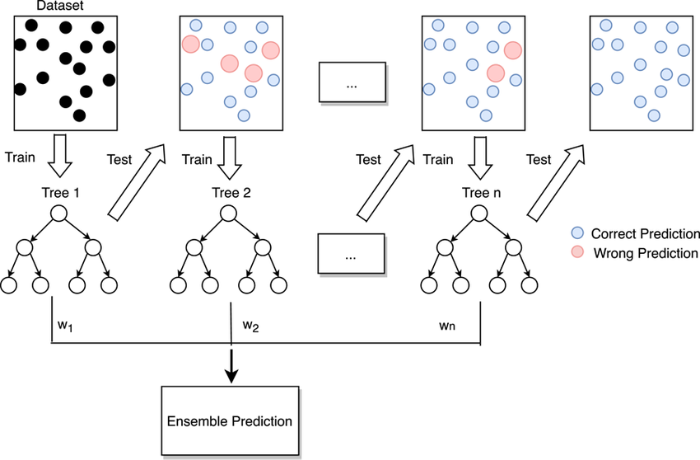
Gradient Boosting classifier
Random forest uses a technique called bagging to build full decision trees in parallel from random bootstrap samples of the data set. The final prediction is an average of all of the decision tree predictions.
Gradient Boosting is an ensemble learning technique that iteratively builds and combines weak models to correct errors and improve predictive accuracy.
We configured Gradient Boosting with 2 trees, a learning rate of 0.3, and a maximum tree depth of 100.

Slide 19
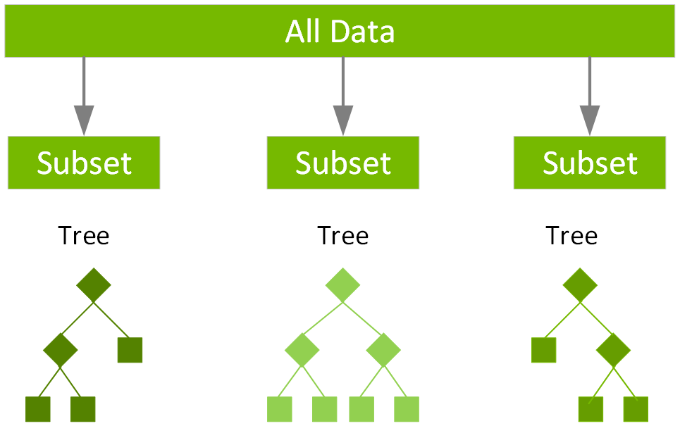
XG Boost
XGBoost (Extreme Gradient Boosting) is a highly efficient and scalable implementation of gradient boosting that enhances predictive performance through advanced optimization techniques.
An optimized and enhanced version of gradient boosting, designed for higher performance and efficiency.
Automatically handles missing data during training, offering a more robust model.
Key Features:
Gradient Boosting Framework: Builds and combines decision trees sequentially to minimize errors.
Regularization: Includes L1 (Lasso) and L2 (Ridge) regularization to prevent overfitting.
Handling Missing Values: Automatically manages missing data during training.
Parallel Processing: Utilizes parallel computation for faster training.
Tree Pruning: Prunes trees to optimize model complexity and performance.

Slide 20
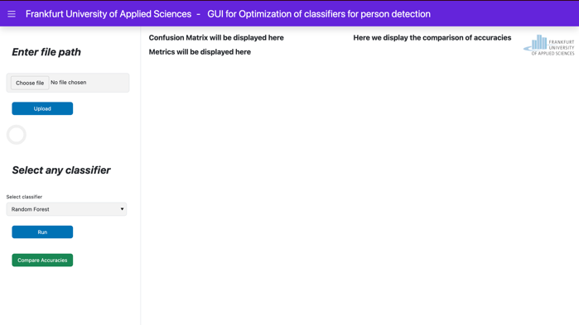
GUI- Panel

Slide 21

Results

Slide 22
Machine Learning Model Accuracy: The project successfully applied Random Forest Classifier (RFC) and Support Vector Machine (SVM),logistic regression, Gradient boosting classifiers, XG boost to predict the presence of individuals in an office environment. The models were trained and validated using confusion matrices, enhancing the sensor system's accuracy and reliability.
Data Collection and Processing: Utilized Red Pitaya and Ultrasonic Sensor SRF02 for data collection, with data processed ADC (Analog to Digital Converter) analysis methodologies. This comprehensive data collection and analysis approach facilitated the extraction of meaningful insights for model training.
Scenario Analysis: Evaluated the sensor system's performance across various scenarios, including empty seats, constant position seating, and movements. These scenarios aimed to mimic real-world conditions as closely as possible to ensure the reliability of the detection system.
Performance Metrics: The study examined key performance metrics, such as accuracy, recall (sensitivity), precision, specificity, and F1 Score, derived from the confusion matrix. These metrics provided a quantitative basis for assessing the effectiveness of the classification algorithms.

Slide 23

Scenario wise comparision with Thresholds
Results were compared across the distinct scenarios:
Seated normally in an upright position.
Seated sideways with body turned.
Leaning forward.
Leaning backward.
Entering the seat.
Exiting the seat.

Slide 24
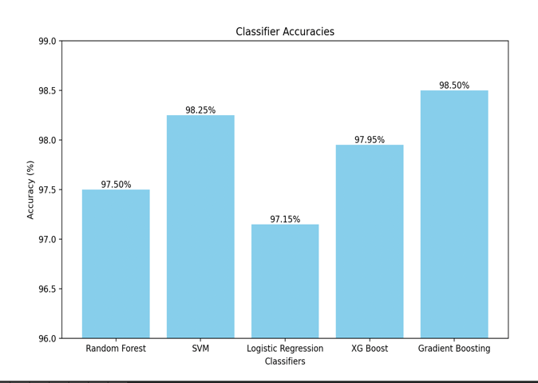
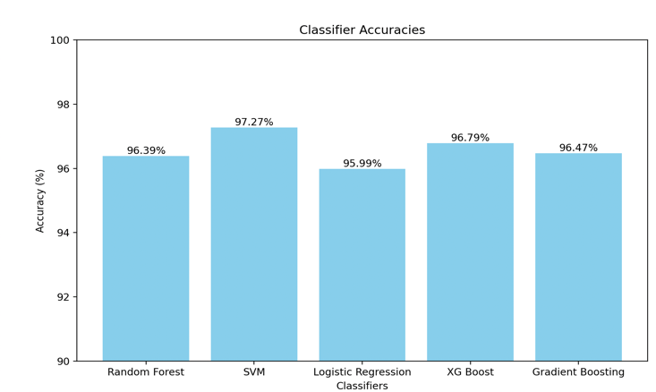
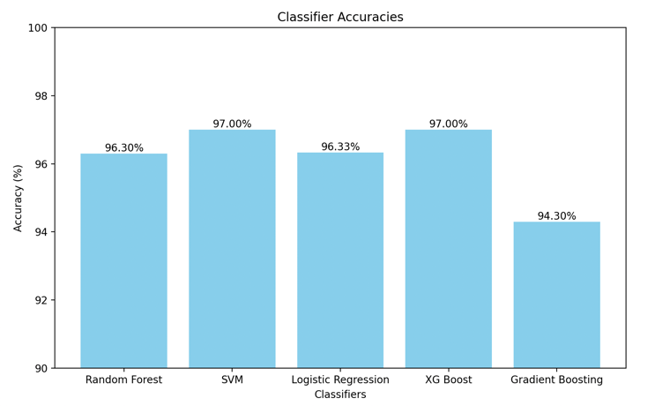
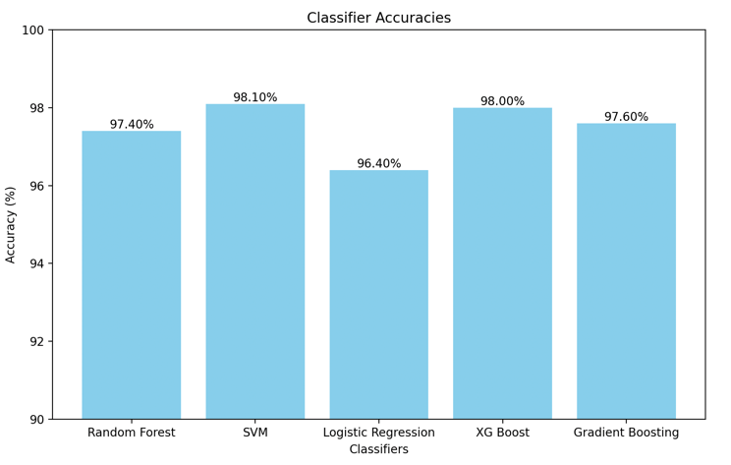
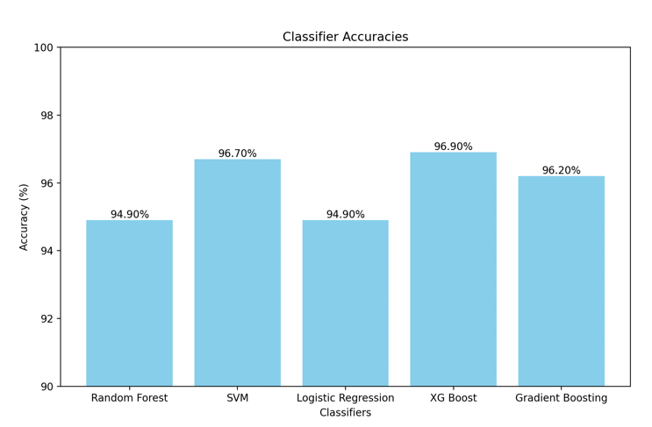
Results of Different Models
person seated normally
Seated sideways with body turned.
Exiting the seat.
Leaned backward scenario.
Leaned forward scenario.

Slide 25
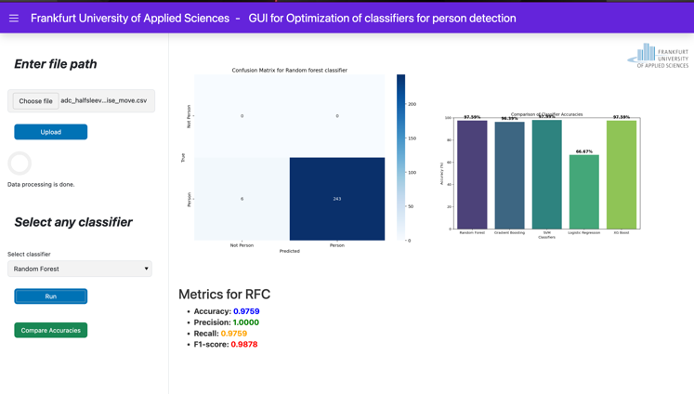
GUI-output

Slide 26
Conclusion
Models Evaluated: Random Forest (RFC), Support Vector Machine (SVM), Logistic Regression (LR), XGBoost, Gradient Boosting
Top Performers:
SVM: 98.1% accuracy (leaned forward), 97.0% (exit position)
XGBoost: Also demonstrated strong performance
Gradient Boosting: Excelled in normal seating (98.5%), less effective in varied postures
Lower Accuracy:
Random Forest & Logistic Regression
GUI Integration:
Enabled user-friendly interaction and intuitive model application
Provided real-time feedback and precise performance visualization

Slide 27
Refernces
[1] | Richards, Mike, Pi Updates and Red Pitaya, Radio User. Bournemouth, UK: PW Publishing Ltd. 11, 2016.
[2] | R. C. Luo, S. L. Lee, Y. C. Wen and C. H. Hsu, “Modular ROS Based Autonomous Mobile Industrial Robot System for Automated Intelligent Manufacturing Applications,” 2020 IEEE/ASME International Conference on Advanced Intelligent Mechatronics (AIM), [Online]. Available: doi: 10.1109/AIM43001.2020.9158800..
[3] | “SRF02 Ultrasonic range finder,” robot-electronics, [Online]. Available: https://www.robot-electronics.co.uk/htm/srf02tech.htm.
[4] | J. Ali, Random Forests and Decision Trees, https://www.researchgate.net, 2012.
[5] | H. Z. S. a. M. H. Hayder Hasan, A Comparison Between Support Vector Machine (SVM) and Convolutional Neural Network (CNN) Models For Hyperspectral Image Classification, 2019.
[6] | K. Balani, S. Deshpande, R. Nair and V. Rane, “Human detection for autonomous vehicles,” IEEE International Transportation Electrification Conference (ITEC), 2015. [Online]. Available: doi: 10.1109/ITEC-India.2015.7386891..
[8] | G. Louppe, Understanding Random Forests: From Theory to Practice, https://arxiv.org/abs/1407.7502.
[9] | T. Chen, XGBoost: A Scalable Tree Boosting System, https://arxiv.org/pdf/1603.02754v3.
[10] | D. K. S. &. B. D. Pathak, Hyperspectral image classification using support vector machine: a spectral spatial feature based approach. Evol. Intel. 15, 1809–1823 (2022). https://doi.org/10.1007/s12065-021-00591-0.
[11] | A. Z. Piotr Florek, “Benchmarking state-of-the-art gradient boosting algorithms for classification,” [Online]. Available: https://ar5iv.labs.arxiv.org/html/2305.17094.
[12] | “TensorFlow,” [Online]. Available: https://www.tensorflow.org/guide/core/logistic_regression_core.
[13] | Y. S. L. C. W. L. Y. A. Zhang, “Support Vector Machine Classification Algorithm and Its Application.Information Computing and Applications. ICICA 2012. Communications in Computer and Information Science,” 2012. [Online]. Available: https://link.springer.com/chapter/10.1007/978-3-642-34041-3_27#citeas.

Slide 28

Thank You

